Slide 1

Object Oriented Analysis and Design with Java
UE20CS352
Dr. Sudeepa Roy Dey
Department of Computer Science and Engineering

Slide 2

UE20CS352: Object Oriented Analysis and Design with Java
Unit-4
Selection or Usage of a Design Patterns

Slide 3
Agenda
Recap of Design Pattern
Types of Design Pattern
Format and section of Design patterns
Selection or Usage of a design Pattern

Slide 4
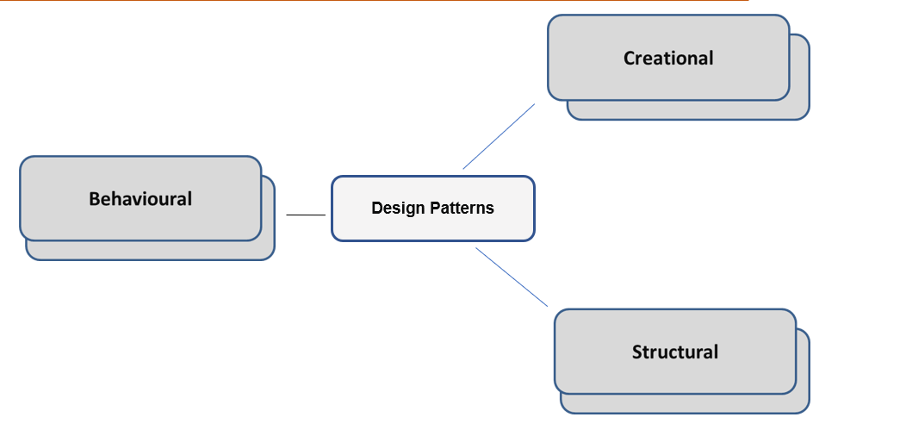
Design pattern-🡪Recap
” Design patterns are used to represent some of the best practices adapted by experienced object-oriented software developers. “
Fig 1: Categories of Design Patterns

Slide 5
Principles of Design Pattern
In 1994, four authors Erich Gamma, Richard Helm, Ralph Johnson und John Vlissides published a book titled Design Patterns - Elements of Reusable Object-Oriented Software which initiated the concept of Design Pattern in Software development.
These authors are collectively known as Gang of Four (GOF). According to these authors design patterns are primarily based on the following principles of object oriented design.
Program to an interface not an implementation
Favor object composition over inheritance

Slide 6
Uses of Design Pattern in Software Development
Design Patterns have two main usages in software development.
Common platform for developers
Design patterns provide a standard terminology and are specific to particular scenario. For example, a singleton design pattern signifies use of single object so all developers familiar with single design pattern will make use of single object and they can tell each other that program is following a singleton pattern.
Best Practices
Design patterns have been evolved over a long period of time and they provide best solutions to certain problems faced during software development. Learning these patterns helps un-experienced developers to learn software design in an easy and faster way.

Slide 7
Why use Design Patterns?
Design Objectives
- Good Design (the “ilities”)
High readability and maintainability
High extensibility
High scalability
High testability
High reusability

Slide 8
Elements of a Design Pattern
A pattern has four essential elements (GoF)
- Name
- Describes the pattern
- Adds to common terminology for facilitating communication (i.e. not just sentence enhancers)
- Problem
- Describes when to apply the pattern
- Answers - What is the pattern trying to solve?

Slide 9
Elements of a Design Pattern (cont.)
- Solution
- Describes elements, relationships, responsibilities, and collaborations which make up the design
- Consequences
- Results of applying the pattern
- Benefits and Costs
-Subjective depending on concrete scenarios

Slide 10
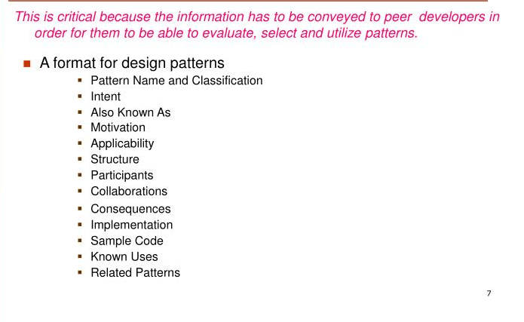
How to describe Design Patterns
These contents help in selection and usage of a design pattern

Slide 11
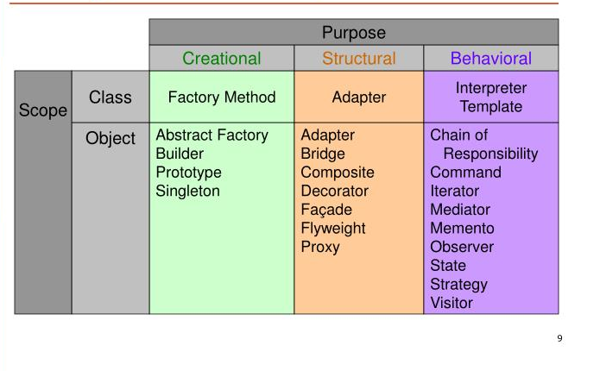
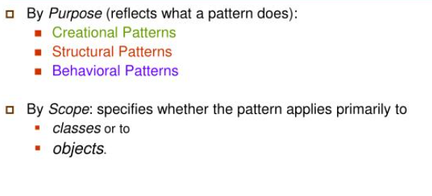
Organizing a Design Pattern space
-
Fig 2: Organizing Design Patterns

Slide 12
Selection of a Design Pattern
As there are 23 patterns in the catalog it will be difficult to choose a design pattern. It might become hard to find the design pattern that solves our problem, especially if the catalog is new and unfamiliar to you. Below is a list of approaches we can use to choose the appropriate design pattern:
-
Consider how design patterns solve design problems: Considering how design patterns help you find appropriate objects, determine object granularity, specify object interfaces and several other ways in which design patterns solve the problems will let you choose the appropriate design pattern.
Scan intent sections: Looking at the intent section of each design pattern’s specification lets us choose the appropriate design pattern.
Study how patterns interrelate: The relationships between the patterns will direct us to choose the right patterns or group of patterns.

Slide 13
Selection of a Design Pattern
Study patterns of like purpose: Each design pattern specification will conclude with a comparison of that pattern with other related patterns. This will give you an insight into the similarities and differences between patterns of like purpose.
Examine a cause of redesign: Look at your problem and identify if there are any causes of redesign. Then look at the catalog of patterns that will help you avoid the causes of redesign
Consider what should be variable in your design: Consider what you want to be able to change without redesign. The focus here is on encapsulating the concept that varies.
-

Slide 14
Usage of Design Pattern-🡪How to use a selected Design Pattern
Below steps will show you how to use a design pattern after selecting one:
Read the pattern once through for a overview:
Give importance to the applicability and consequences sections(in format) to ensure that the pattern is right for your problem.
Study the structure, participants and collaborations sections:
Make sure to understand the classes and objects in the pattern and how they relate to one another.
Look at the sample code section to see a concrete example of the pattern in action:
Studying the code helps us to implement the pattern.
-

Slide 15
Usage of a Design Pattern-🡪How to use a Design Pattern
Define the classes:
Declare their interfaces, inheritance relationships and instance variables, which represent the data and object references. Identify the affected classes by the pattern and modify them accordingly.
Define application-specific names for the operations in the pattern:
Use the responsibilities and collaborations as a guide to name the operations. Be consistent with the naming conventions.
Implement the operations to carry out the responsibilities and collaborations in the pattern:
The implementation section provides hints to guide us in the implementation. The examples in the sample code section can also help as well.
-

Slide 16
References
https://sourcemaking.com/design_patterns/
https://refactoring.guru/design-patterns/java
https://www.startertutorials.com/patterns/select-design-pattern.html
Design Patterns: Elements of Reusable Object-Oriented SoftwareErich Gamma, ‎Ralph Johnson, ‎Richard Helm · 1995

Slide 17
THANK YOU
Dr. Sudeepa Roy Dey and Dr Geetha D
Department of Computer Science and Engineering

